Slide 1
COMP 4300 Computer Architecture
Scoreboard: An Example
Part 2
Dr. Xiao Qin
Auburn University
http://www.eng.auburn.edu/~xqin
xqin@auburn.edu
Notes:
Lec13c: 50 min: slides 1-16
Lec14a: slides 17-36

Slide 2
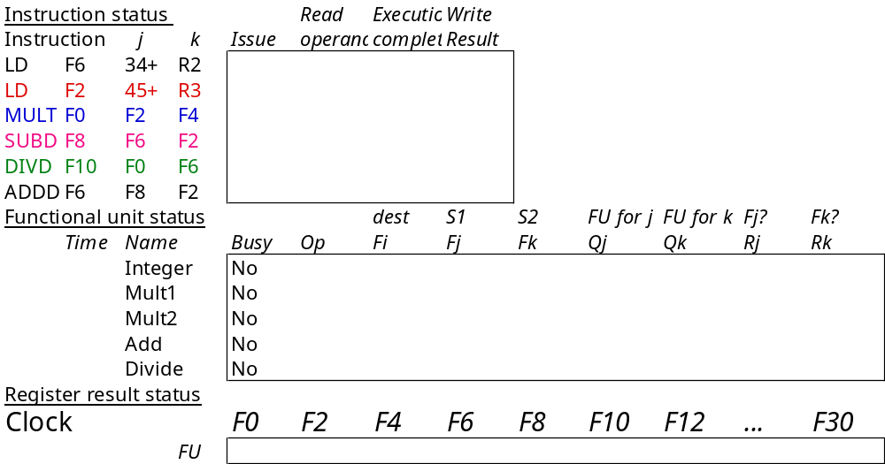
Scoreboard Example

Slide 3
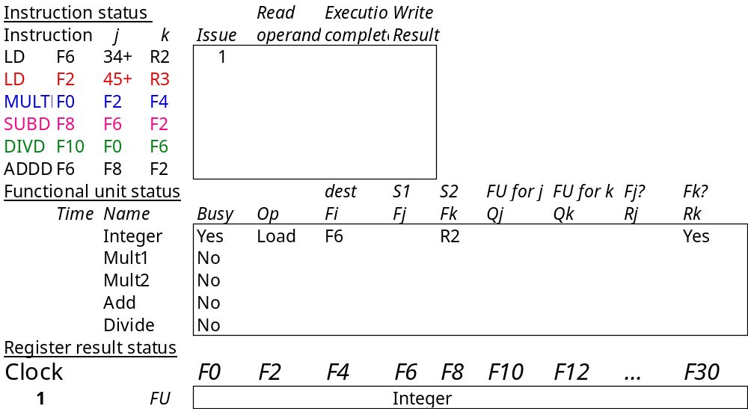
Scoreboard Example Cycle 1
Issue LD #1
Shows in which cycle the operation occurred.

Slide 4

Scoreboard Example Cycle 2
Can we issue LD #2?
integer unit is busy.
Can we issue MULT?
we require in-order issue.

Slide 5
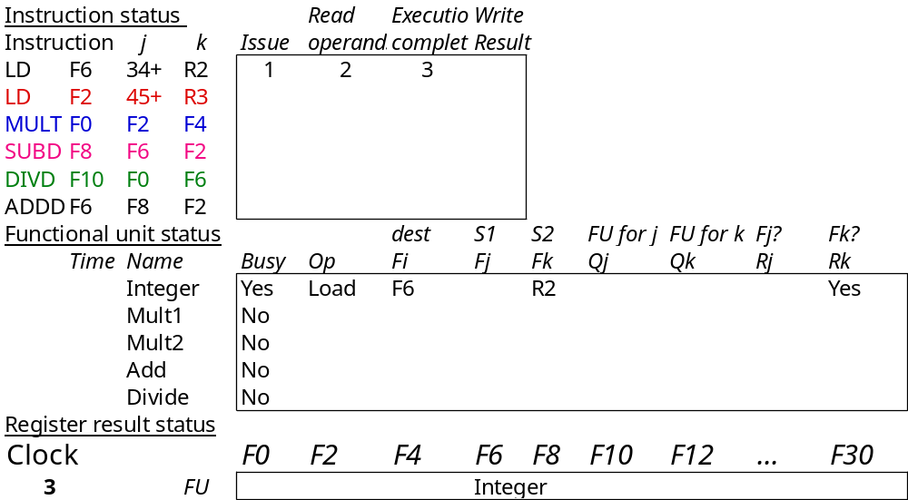
Scoreboard Example Cycle 3

Slide 6

Scoreboard Example Cycle 4
What happens next?

Slide 7
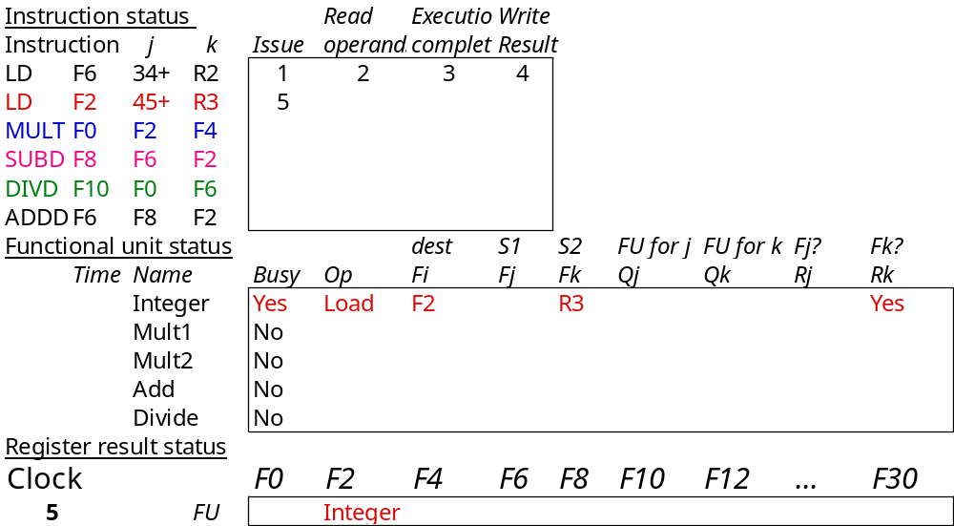
Scoreboard Example Cycle 5
Issue LD #2 since integer unit is now free.

Slide 8
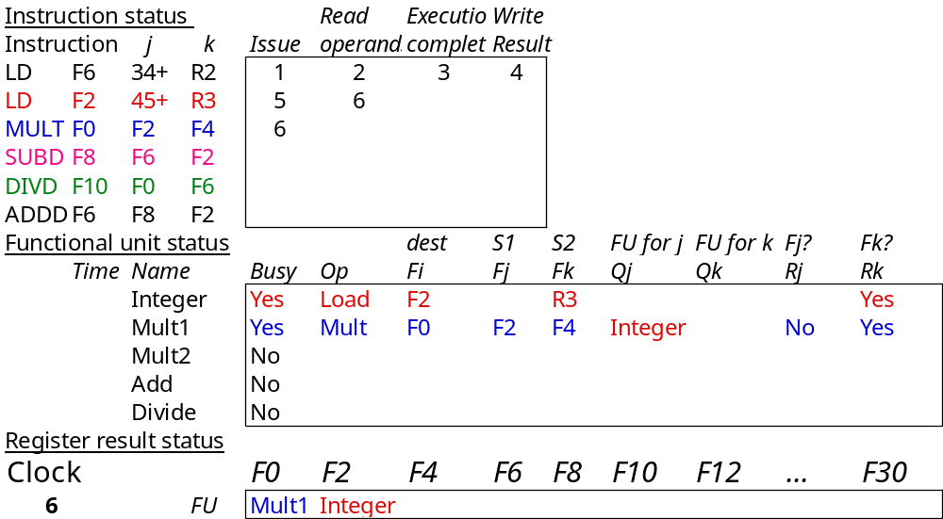
Scoreboard Example Cycle 6
Issue MULT.
Notes:
An error? F4

Slide 9
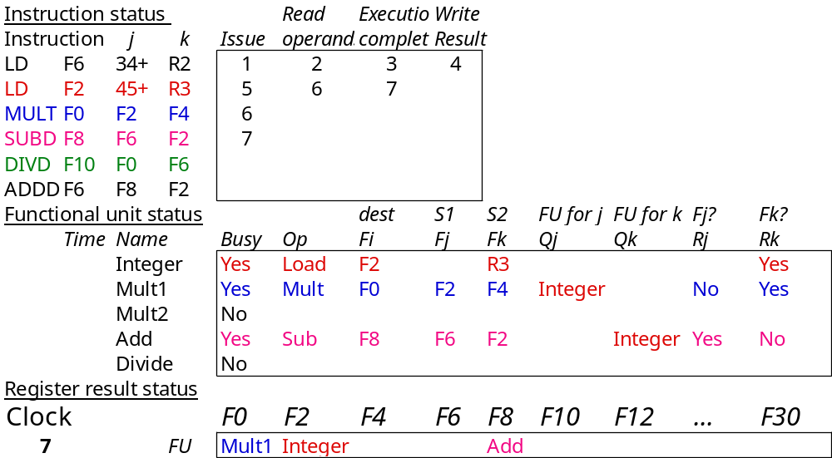
Scoreboard Example Cycle 7
Can MULT read its operands?
(F2) because LD #2 hasn’t finished.

Slide 10
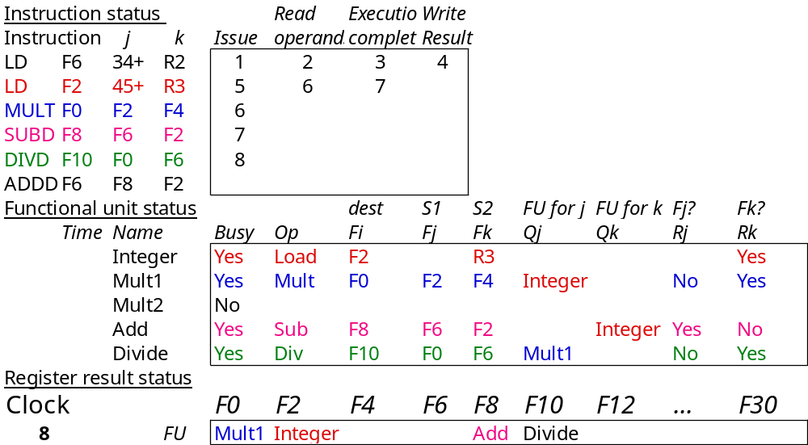
Scoreboard Example Cycle 8a
DIVD issues.
MULT and SUBD both waiting for F2.

Slide 11
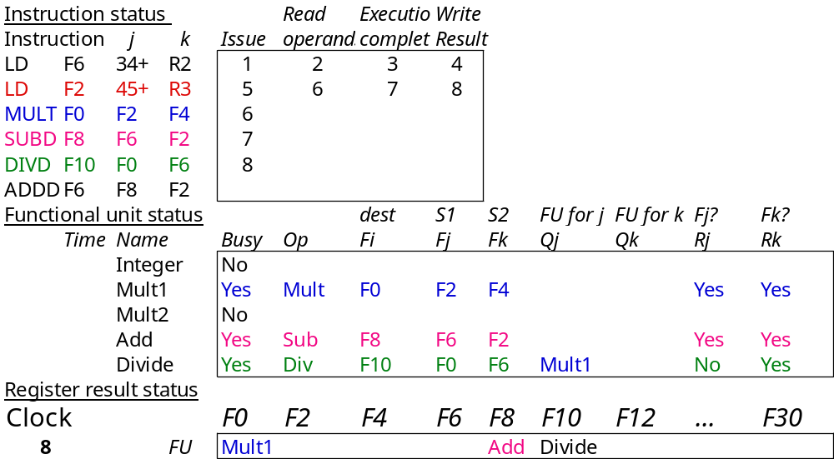
Scoreboard Example Cycle 8b
LD #2 writes F2.

Slide 12
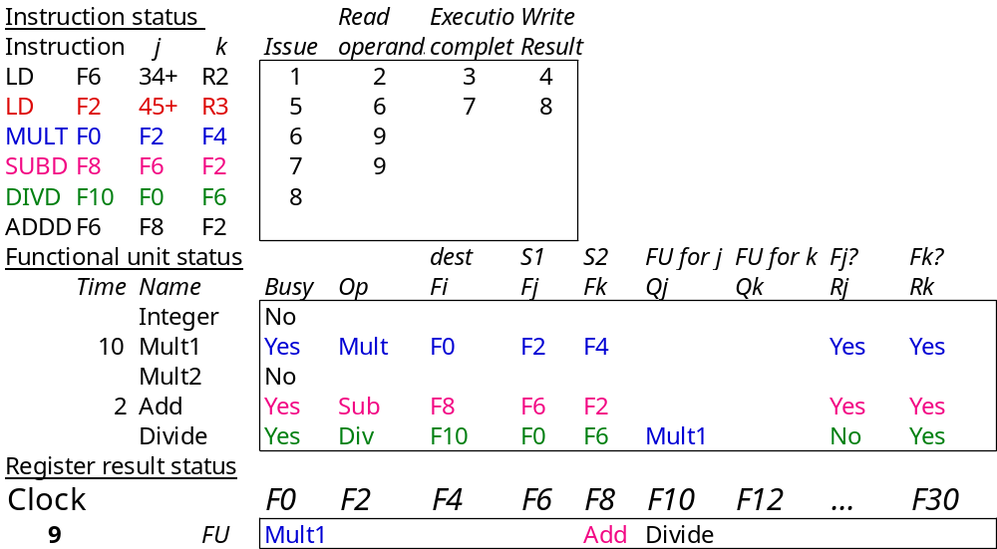
Scoreboard Example Cycle 9
Now MULT and SUBD can both read F2.
How can both instructions do this at the same time??

Slide 13
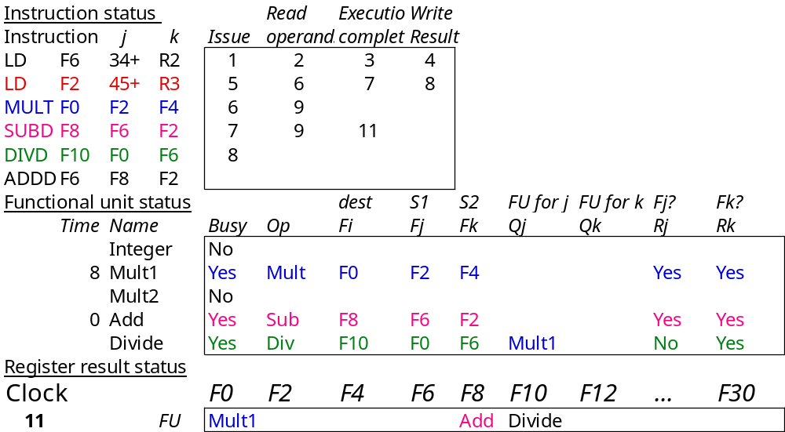
Scoreboard Example Cycle 11
ADDD can’t start because?
add unit is busy.

Slide 14
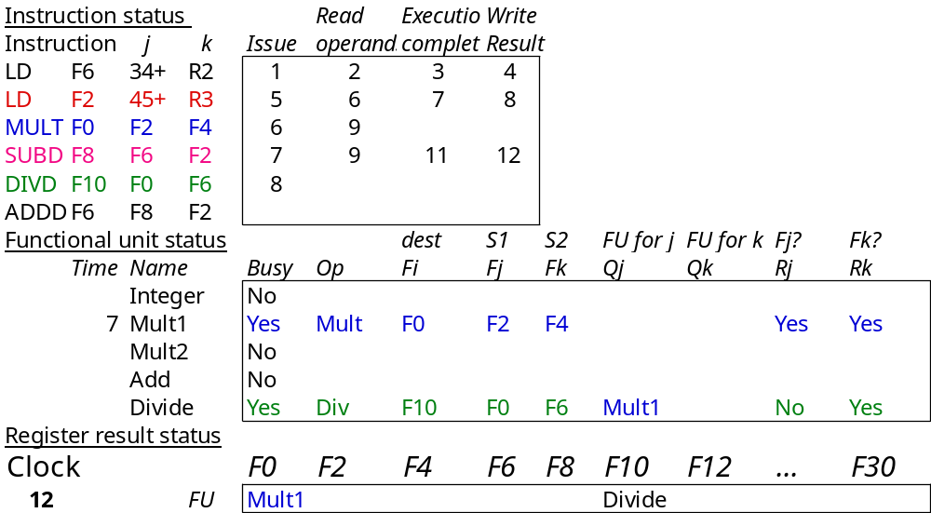
Scoreboard Example Cycle 12
SUBD finishes.
DIVD waiting for F0.

Slide 15
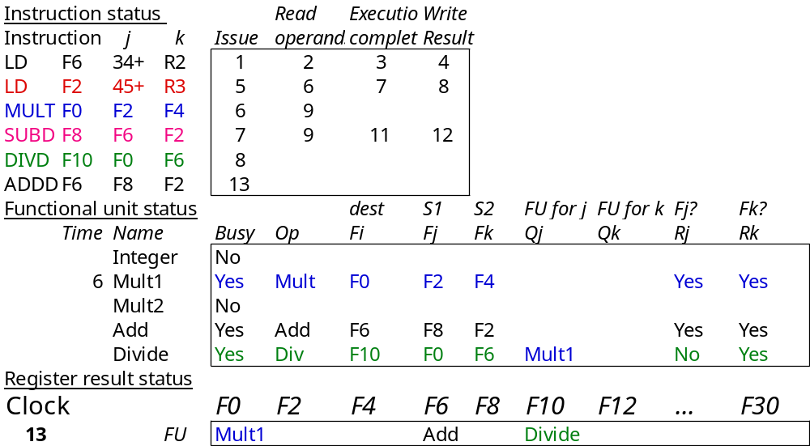
Scoreboard Example Cycle 13
ADDD issues.

Slide 16
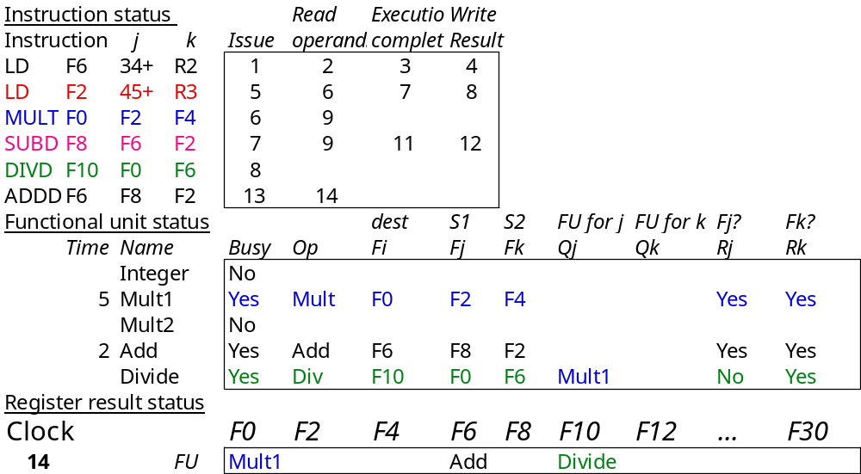
Scoreboard Example Cycle 14

Slide 17
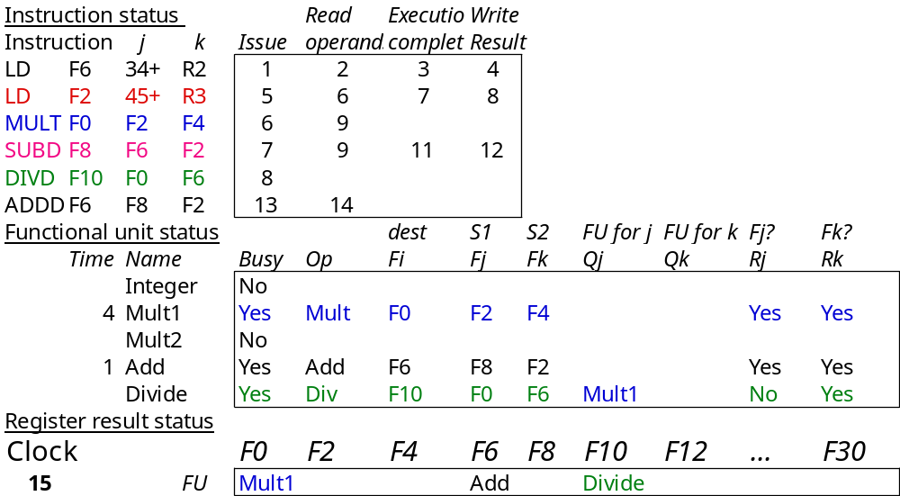
Scoreboard Example Cycle 15

Slide 18
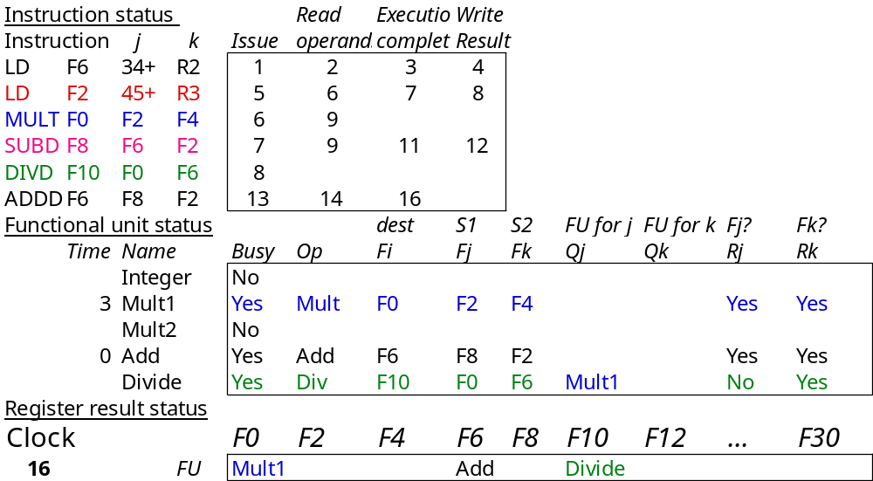
Scoreboard Example Cycle 16

Slide 19
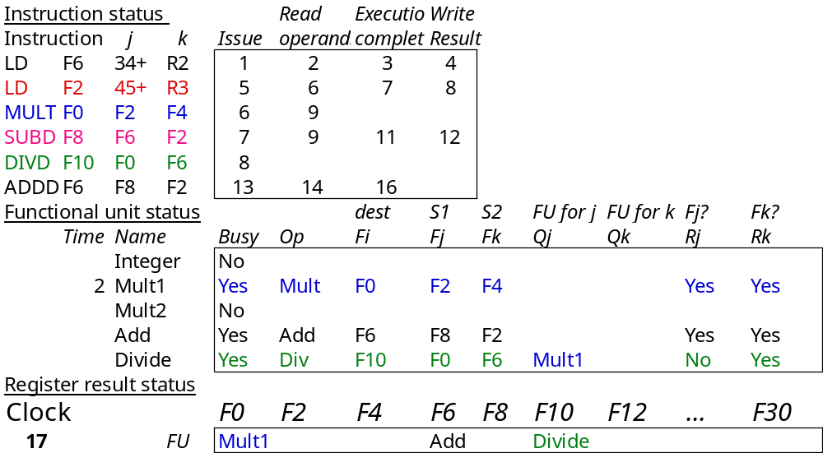
Scoreboard Example Cycle 17
Can ADDD write? Why?
No! Because of DIVD. WAR!

Slide 20

Scoreboard Example Cycle 18
Nothing Happens!!

Slide 21
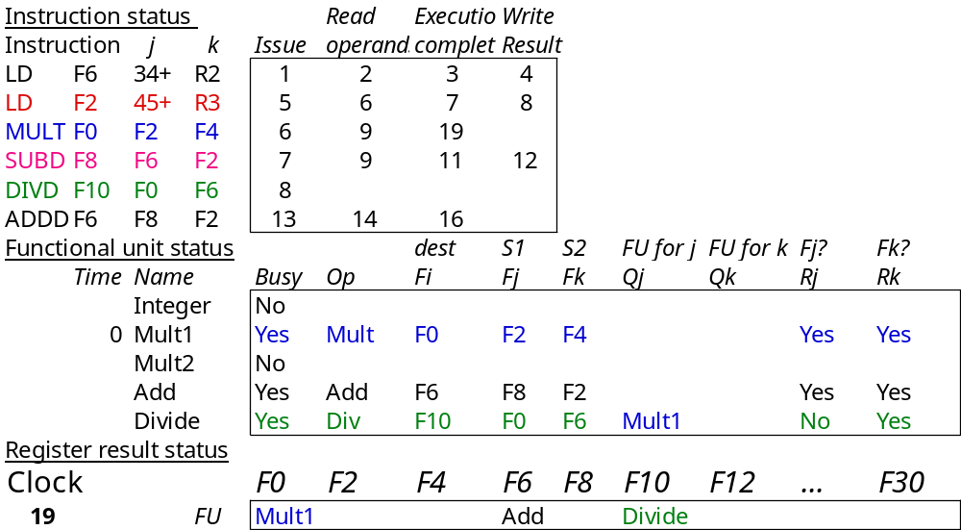
Scoreboard Example Cycle 19
MULT completes execution.

Slide 22
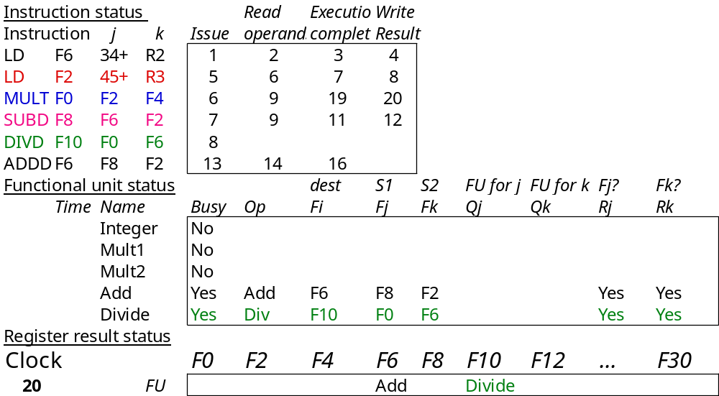
Scoreboard Example Cycle 20
MULT writes.

Slide 23

Scoreboard Example Cycle 21
DIVD loads operands

Slide 24
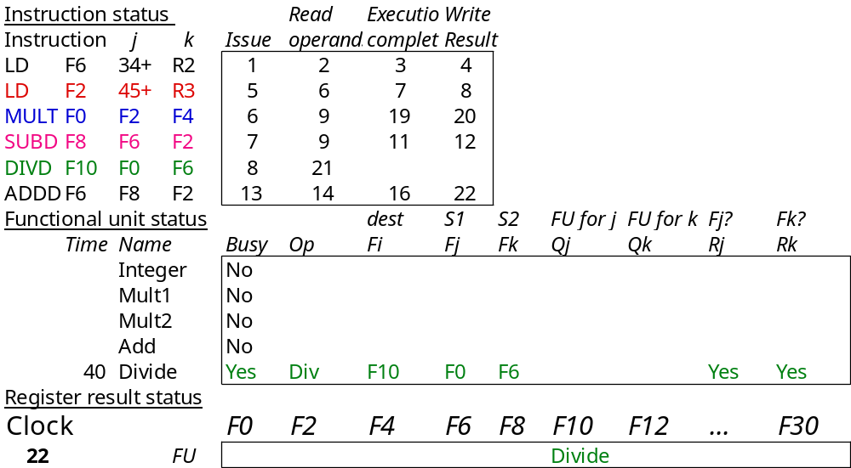
Scoreboard Example Cycle 22
Now ADDD can write ?
Yes! Since WAR removed.

Slide 25
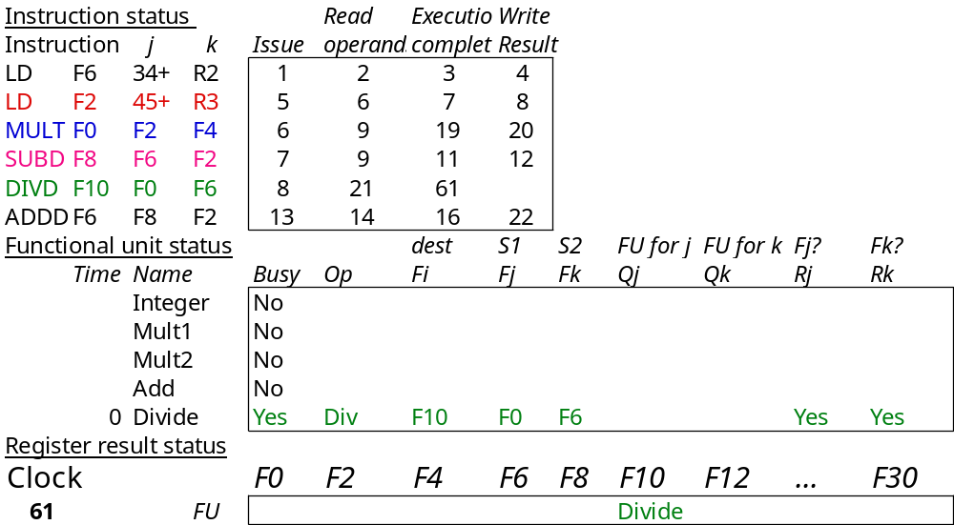
Scoreboard Example Cycle 61
DIVD completes execution

Slide 26
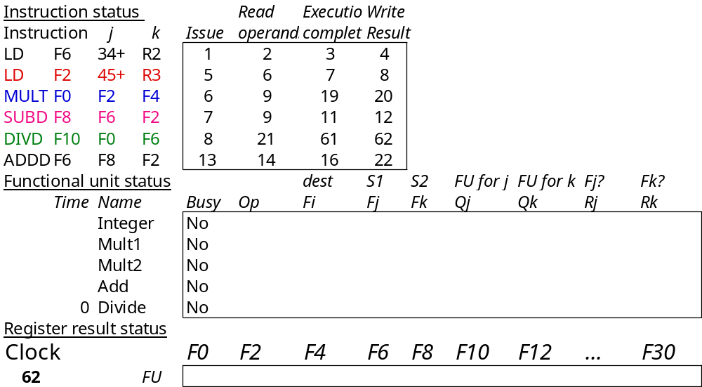
Scoreboard Example Cycle 62
DONE!!

Slide 27
Detailed Scoreboard Pipeline Control
Instruction status
Wait until
Bookkeeping
Avoid Structural and WAW Hazards
Issue
Not Busy(FU) and not Result(D)
Busy(FU)← yes; Op(FU)← op;
Fi(FU)← `D’; Fj(FU)← `S1’;
Fk(FU)← `S2’; Qj← Result(‘S1’);
Qk← Result(`S2’); Rj← not Qj;
Rk← not Qk; Result(‘D’)← FU;
Avoid RAW Hazards
Read operands
Rj and Rk
Rj← No; Rk← No
Execution complete
Functional unit done
Write result
∀f((Fj( f )≠Fi(FU)
or Rj( f )=No) & (Fk( f ) ≠Fi(FU)or
Rk( f )=No))
∀f(if Qj(f)=FU then Rj(f)← Yes);
∀f(if Qk(f)=FU then Rj(f)← Yes); Result(Fi(FU))← 0; Busy(FU)← No
Avoid WAR Hazards
Notes:
1.Issue - if no structural haards AND non wAW (no Funtional Unit is going to write this destination register; 1 per clock cycle
2. Read -(RAW) if no instructions is going to write a source register of this instruction (alternatively, no write signal this clock cycle) +> gein exection of the instruction; many read ports, so can read many times
3. Execution Complete; multiple during clock cyle
4. Write result - (WAR) If no instructiion is watiing to read the destination register; assume multiple wriite ports; wait for clock cycle to write and tehn read the results; assume can oerlap issue & write
show clock cyclesneed 20 or so
Latency: minimum is 4 through 4 stages

Slide 28
Limitations of Scoreboard
The amount of parallelism available among the instructions (chosen from the same basic block)
The number of score entries (The size of the window is a basic block)
The number and types of functional units (Structural hazards increase when dynamic scheduling is used)
The presence of antidependence and output dependences lead to WAR and WAW stalls.
Notes:
The amount of parallelism available among the instructions—This determines
whether independent instructions can be found to execute. If each
instruction depends on its predecessor, no dynamic scheduling scheme can
reduce stalls. If the instructions in the pipeline simultaneously must be chosen
from the same basic block (as was true in the 6600), this limit is likely to
be quite severe.
The number of scoreboard entries—This determines how far ahead the pipeline
can look for independent instructions. The set of instructions examined
as candidates for potential execution is called the window. The size of the
scoreboard determines the size of the window. In this section, we assume a
window does not extend beyond a branch, so the window (and the scoreboard)
always contains straight-line code from a single basic block. Chapter 2
shows how the window can be extended beyond a branch.
The number and types of functional units—This determines the importance of
structural hazards, which can increase when dynamic scheduling is used.
The presence of antidependences and output dependences—These lead to
WAR and WAW stalls.

Slide 29
Summary
Techniques to deal with data hazards in instruction pipelines by:
  Result forwarding to reduce or eliminate RAW hazards
  Hazard detection hardware to stall the pipeline during hazards
  Compiler-based static scheduling to separate the dependent instructions minimizing actual hazard-prevention stalls in scheduled code.
  Uses a hardware-based mechanism to rearrange instruction execution order to reduce stalls dynamically at runtime (dynamic scheduling)
    Better dynamic exploitation of instruction-level parallelism (ILP)
    We learned scoreboard techniques today
    We will learn another technique Tomasulo next.

